Slide 1
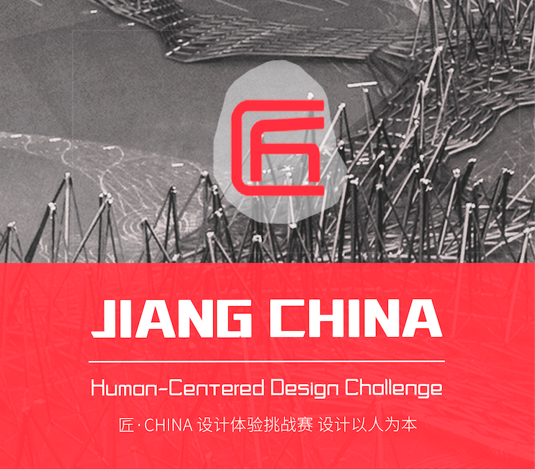
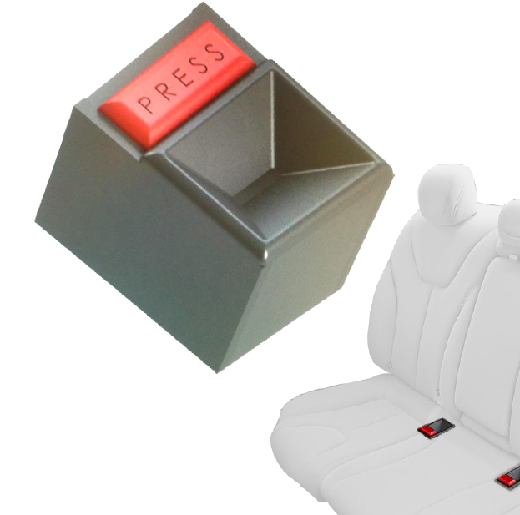
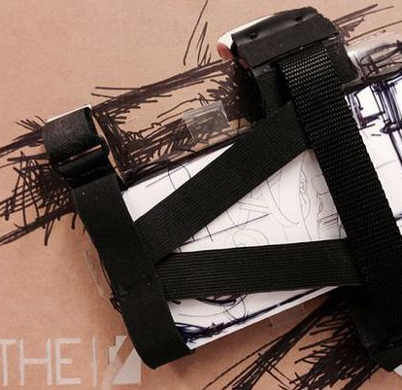
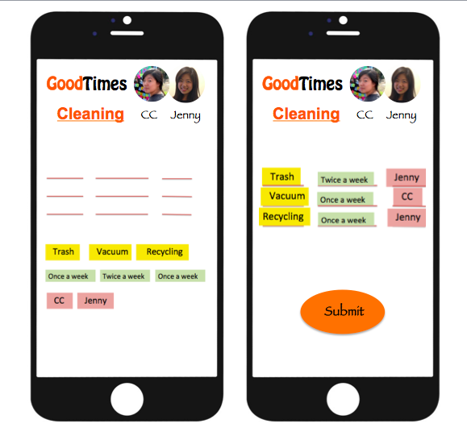
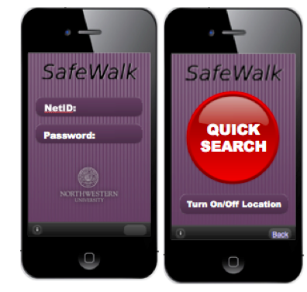
Jenny Wang
Human-Centered
Designer
Work
About
Play
jennywjs814@gmail.com
LinkedIn
Resume

Slide 2

Jenny Wang
Human-Centered
Designer
Work
About
Play
Jenny Wang is a human-centered design strategist, an experimenter and a deliver. She likes using human-centered design to think and prototype, getting her hands dirty to explore and make things. She also believes that design could facilitate implementing and delivering the actual impact to the end users of a product or service. Jenny loves working on design challenges where she sees potentials for improving users’ experiences and creating meaningful impact to the society.
Jenny also founded a human-centered design organization to teach more people the human-centered design methodologies to seed impact through education.
Contact Info: jennywjs814@gmail.com
jennywjs814@gmail.com
LinkedIn
Resume

Slide 3

Jenny Wang
Human-Centered
Designer
Work
About
Play
jennywjs814@gmail.com
LinkedIn
Resume

Slide 5
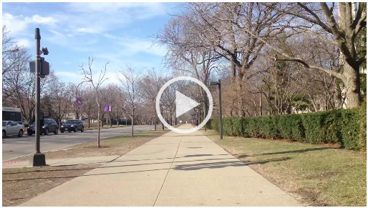
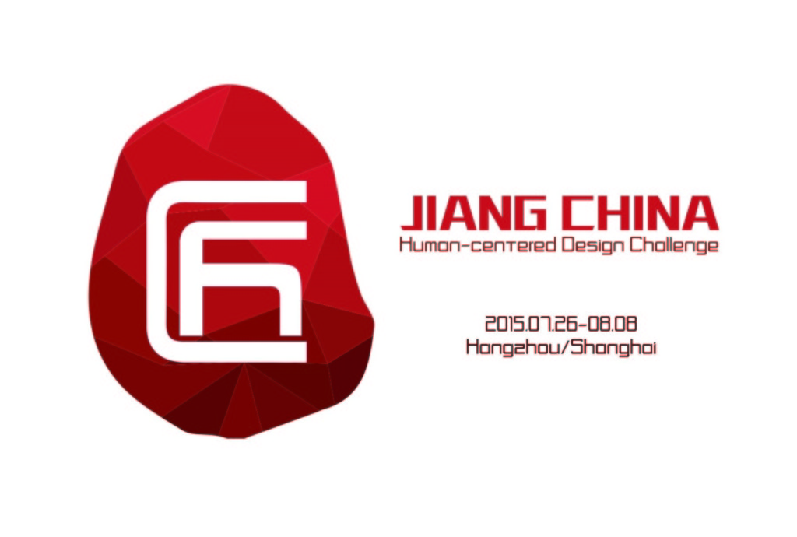
Jenny founded Jiang China Design Initiative in October 2014.

